Slide 1
Integrated literacy assignment
Ashley Short
SST 309-03
November 8, 2012

Slide 2
g.l.c.e
K-H2.0.1
Distinguish among yesterday, today, tomorrow.

Slide 3
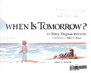
Books
When is Tomorrow?
By: Nancy Dingman Watson

Slide 4
Songs
Sesame Street
Sesame Street: Yesterday, Today and Tomorrow
Annie
Annie: Tomorrow
Ron Brown
Ron Brown: Yesterday, Today, Tomorrow
Lyric Page
Kids Singing
Kids Singing

Slide 5
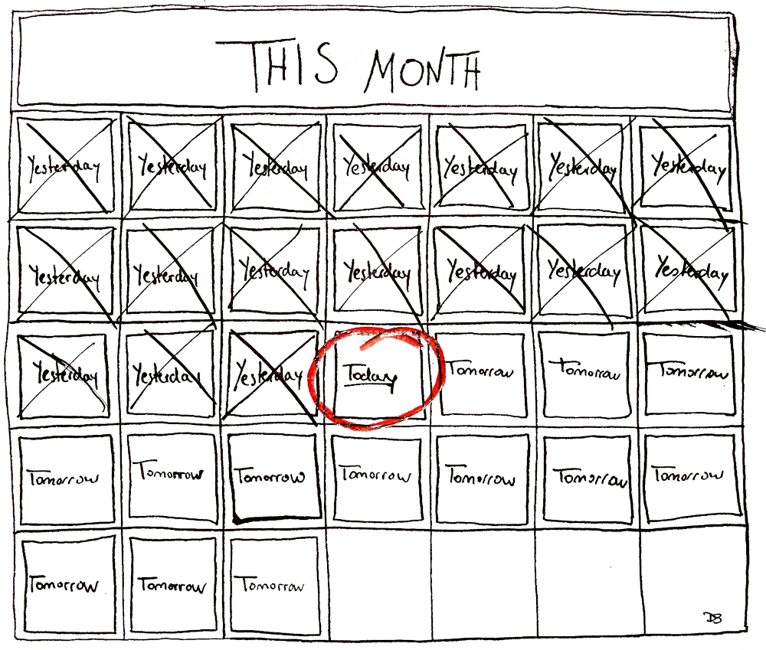
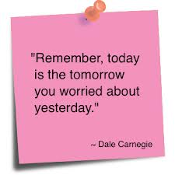
Quotes/pictures

Slide 6
Videos
Busy Beavers
Level Two
Busy Beavers Website
Level Three
Busy Beavers Lesson

Slide 7
Handouts & games
Worksheet #1 (Drawing)
Draw
Worksheet #2 (Handout or Quiz)
Handout or Quiz
Yesterday, Today, Tomorrow
Enrichment Game

Slide 8
Web resources
Unit 6 Lesson 28: Today, Yesterday & Tomorrow
Lesson
Comparison Lesson
Comparison
Lesson Plan
Bright Hub Education
Timeline
http://library.salve.edu/ace/kit1/Lesson1.pdf

Slide 9
Works cited
"Learn English Online." - Free Beginners Course. N.p., n.d. Web. 08 Nov. 2012. <http://www.learn-english- online.org/Lesson28/Lesson28.htm>.
"Level-2-Section-3 Â« Busy Beavers â Kids Learn English Songs." Level-2-Section-3 Â« Busy Beavers â Kids Learn English Songs. N.p., n.d. Web. 08 Nov. 2012. <http:// busybeavers.com/level-2-section-3/>.
"Making ESL Lessons on Yesterday, Today and Tomorrow Fun for Teachers and Students." Bright Hub Education. N.p., n.d. Web. 08 Nov. 2012. <http:// www.brighthubeducation.com/esl-lesson-plans/125637- esl-yesterday-today-tomorrow/>.
"Printable Handout: Yesterday, Today & Tomorrow." Yesterday, Today & Tomorrow. N.p., n.d. Web. 08 Nov. 2012. <http://www.usingenglish.com/handouts/241.html>.
Sakuraalovex. "Tomorrow- Annie Lyricsâ¥." YouTube. YouTube, 19 May 2011. Web. 08 Nov. 2012. <http:// www.youtube.com/watch?v=VlQ64ckJnLw>.
"Sesame Street - Yesterday, Today and Tomorrow." YouTube. YouTube, 31 July 2010. Web. 08

Slide 10
Work cited continued
Nov. 2012. <http://www.youtube.com/watch?v=riUz5IP__Ro>.
"Yesterday, Today, and Tomorrow Poems." WritingFix: An IPod- inspired Writing Lesson. N.p., n.d. Web. 08 Nov. 2012. <http://writingfix.com/i_pod_prompts/Yesterday3.htm>.
"Yesterday Today and Tomorrow." Watch Video Teaching Math at Blinkx. N.p., n.d. Web. 08 Nov. 2012. <http:// www.blinkx.com/watch-video/yesterday-today-and- tomorrow/CdHbBaASGAHJxACQY4V_bQ>.
"Yesterday Today Tomorrow." Game. N.p., n.d. Web. 08 Nov. 2012. <http://www.games68.com/games.php?id=228365>.
"Yesterday, Today, Tomorrow: Song Lyrics and Sound Clip." Yesterday, Today, Tomorrow: Song Lyrics and Sound Clip. N.p., n.d. Web. 08 Nov. 2012. <http:// www.songsforteaching.com/intellitunes/ yesterdaytodaytomorrow.htm>.
YouTube. YouTube, n.d. Web. 08 Nov. 2012. <http:// www.youtube.com/watch?v=78AaaKs-PsY>.

